Slide 1


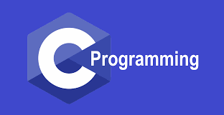
Chapter: 7
C Programs with Mustafa Rahman
Web & Software Developer
C360Soft.Ai, India. (Remote Job)
ICT Lecturer of MIFM

Slide 2
Arrays
Collection of similar data types stored at
contiguous memory locations

Slide 3

Syntax
int marks[3];
char name[10];
float price[2];

Slide 4
Input & Output
scanf("%d", &marks[0]);
printf("%d", marks[0]);

Slide 5

Inititalization of Array
int marks[ ] = {97, 98, 89};
int marks[ 3 ] = {97, 98, 89};
Memory Reserved :

Slide 6

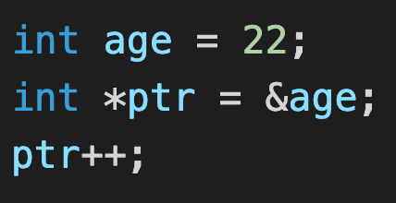
Pointer Arithmetic
Pointer can be incremented
& decremented
CASE 1

Slide 7

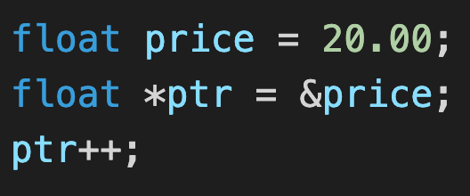
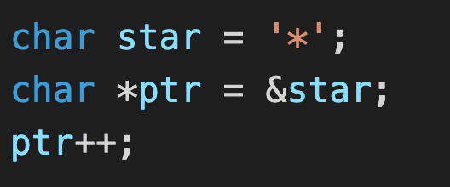
Pointer Arithmetic
CASE 2
CASE 3

Slide 8
Pointer Arithmetic
- We can also subtract one pointer from another
- We can also compare 2 pointers

Slide 9
Array is a Pointer
int *ptr = &arr[0];
int *ptr = arr;

Slide 10


Traverse an Array
int aadhar[10];
int *ptr = &aadhar[0];

Slide 11
Arrays as Function Argument
//Function Declaration
void printNumbers (int arr[ ], int n)
OR
void printNumbers (int *arr, int n)
//Function Call
printNumbers(arr, n);

Slide 12
Multidimensional Arrays
2 D Arrays
int arr[ ][ ] = { {1, 2}, {3, 4} };//Declare
//Access
arr[0][0]
arr[0][1]
arr[1][0]
arr[1][1]

